Slide 1
Visualizations for Crime Against Women in India
Akash Gautam (2013008) Gaurav Yadav(2013037)
Vedaint Solanki(2014117)

Slide 2
Motivation
Crime has always been one of the larger problems in India, especially since it is the second most populous country in the world, and a bane of India’s development efforts.
The skewed sex ratio, age-old customs like Sati and Dowry and the lower status women hold in society leave women at higher risk to become victims of sexualized violence.
The safety of women has suddenly become a national priority; the issue has gained visibility through different journalistic media, we tried to contribute to same using Data Analysis trategies.

Slide 3
Project Goals
We aim to create a series of visualizations to allow exploration and analysis of data about Crime Against Women in India. Using several categories of data. Visualizations so that any one can understand different crimes in different states as per their requirements.

Slide 4
Data-Set Info
The data refers to district wise details on crimes against women during the years . The nature of such crimes includes Rape, Kidnapping and Abduction, Dowry Death, Assault on women with intent to outrage her modesty, Insult to modesty of Women, Cruelty by Husband or his Relatives and Importation of Girls.
Data being used from https://data.gov.in/ for crimes against women
From 2001 to 2012
2013
2014
2015

Slide 5
We tried to show the following
Year-wise Number of Rapes in different states.
Number of Dowry Deaths in different States from 2001 till 2015.
Mix line plots for each state differently showing how different crimes have changed over this time period.
We also tried to plot how different states have been successfully curbed on these crime rates while how some failed miserably over same.

Slide 6
Visualizations 1 - Rapes
With these visualizations we tried to show Number of Rapes have been changing in a state of user choice over past years and how will they be going through for upcoming years.
As we can’t put all graphs here, so we have graphs for major cities as follows:

Slide 7
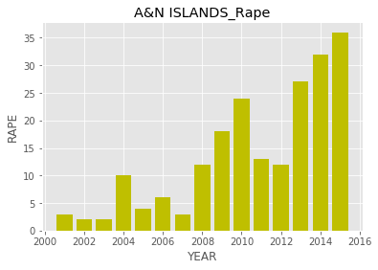
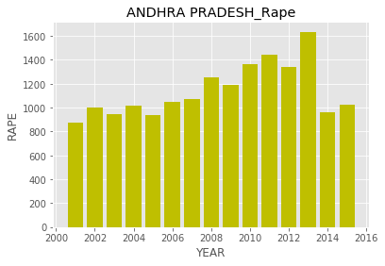
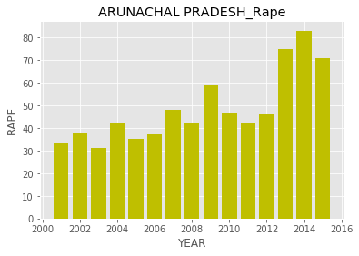
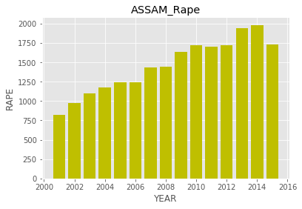
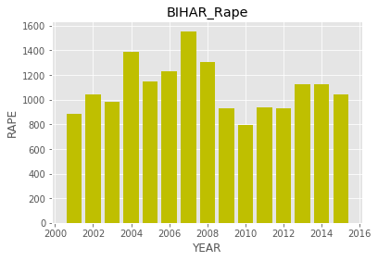

Slide 8
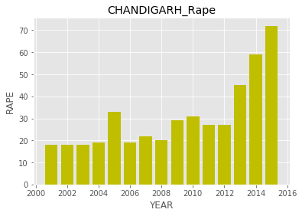
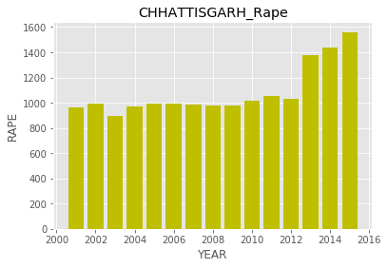
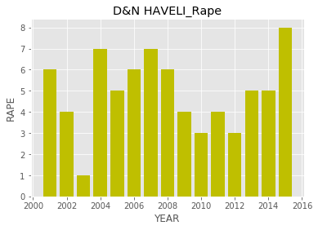
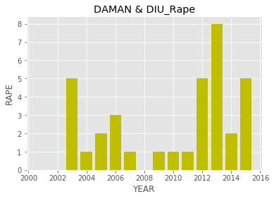
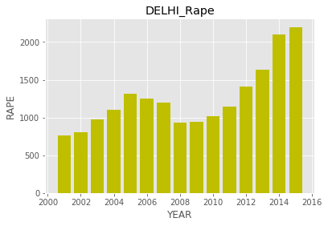

Slide 9
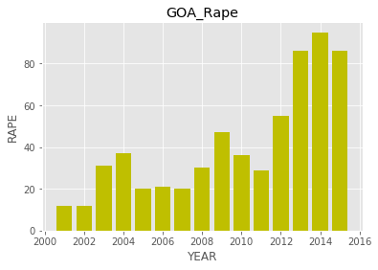
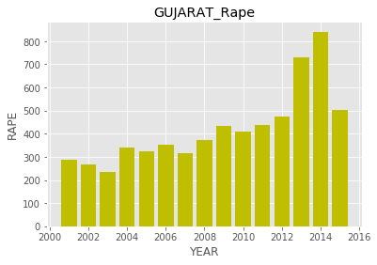
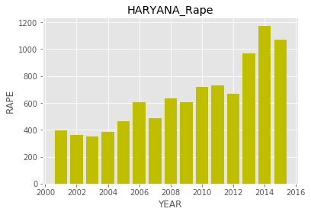
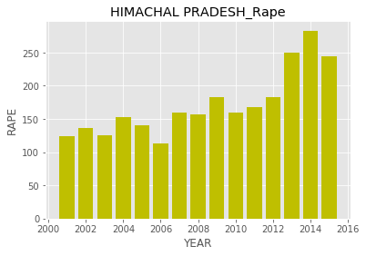
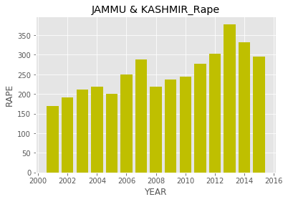

Slide 10
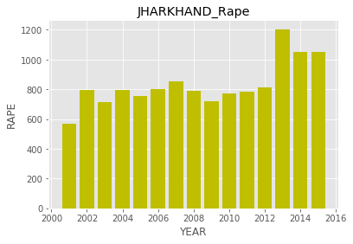
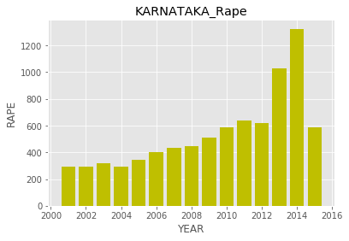
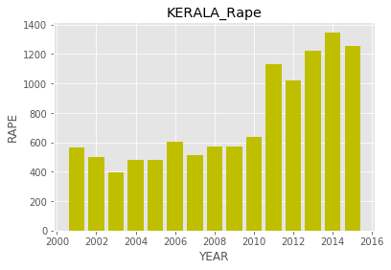
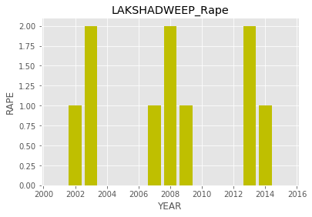
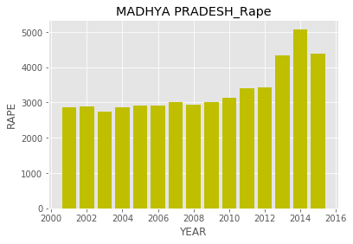

Slide 11
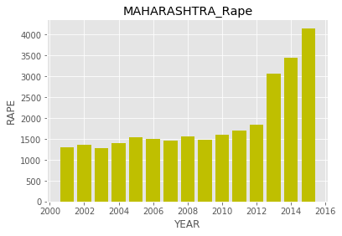
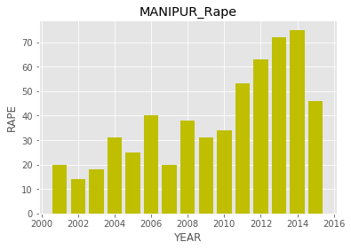
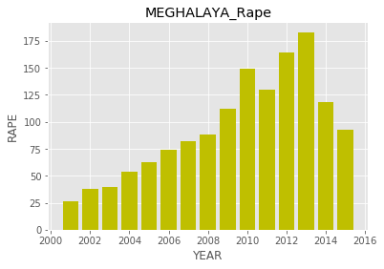
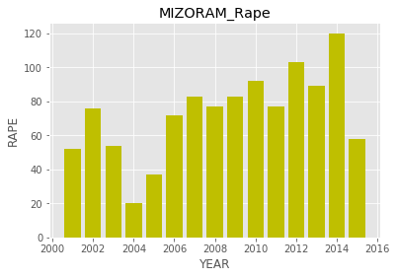
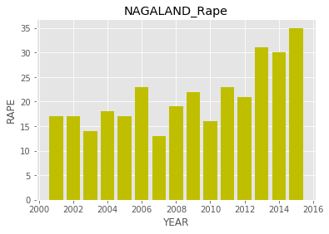

Slide 12
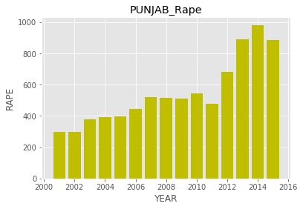
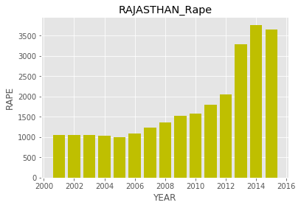
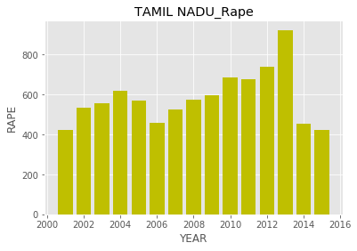
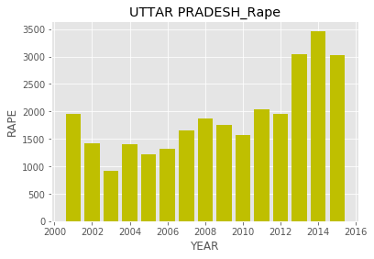
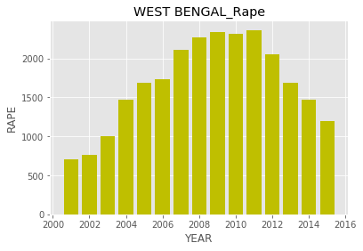

Slide 13
Visualizations 2 - Different crimes Statistics
With these visualizations we tried to show how different crime against women’s have been changing over time or it can be used to check major problems over time in a particular state.
As we can’t put all graphs here, so we have graphs for major cities as follows:

Slide 14
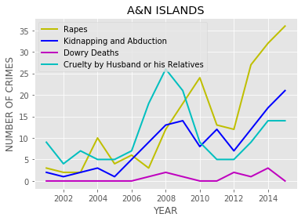
A&N ISLANDS
INCREASE IN NUMBER OF RAPES TILL THE END OF 2015.
DOWRY DEATHS BEING VERY LOW THROUGHOUT THIS PERIOD.

Slide 15
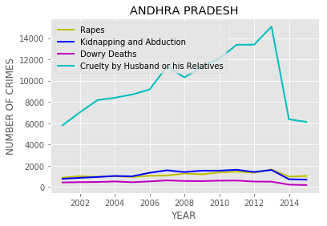
ANDHRA PRADESH
VERY HIGH NUMBER OF CASES FOR CRUELTY AGAINST WOMEN BY HUSBAND OR HIS RELATIVES.

Slide 16
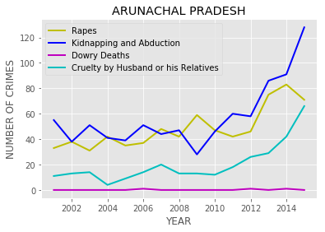
ARUNACHAL PRADESH
CLEARLY SHOWS A STEEP INCREASE IN NUMBER OF KIDNAPPING AND ABDUCTION CASES.

Slide 17
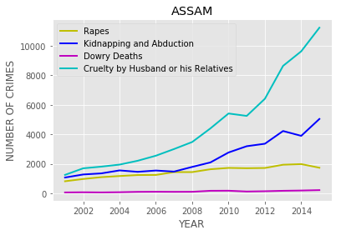
ASSAM
CRUELTY BY HUSBAND OR HIS RELATIVES BEING THE HIGHEST COMMITTED CRIME IN ASSAM.
GOVT. SHOULD WORK ON WAYS TO BRING THEM DOWN BY SPREADING AWARENESS.

Slide 18
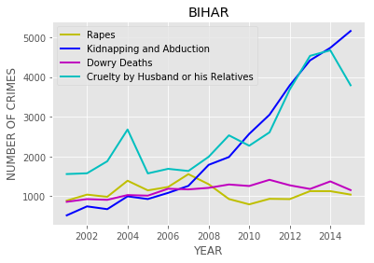
BIHAR
RAPES AND DOWRY DEATHS BEING LOW RELATIVE TO KIDNAPPING AND CRUELTY CASES IN BIHAR.
BUT STILL KIDNAPPING AND ABDUCTION CASES ARE BEING VERY HIGH AND STILL INCREASING.

Slide 19
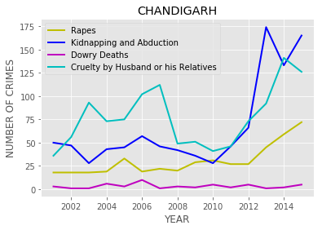
CHANDIGARH
2014 SAW A SMALL FALL IN NUMBER OF KIDNAPPING AND ABDUCTION CASES.
WHILE BY THE END OF 2015 INCREASE IN NUMBER OF RAPE CASES CAN’T BE IGNORED.

Slide 20
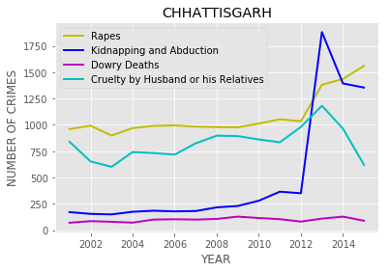
CHHATTISGARH
CHHATTISGARH ALSO SAW A INCREASE NUMBER OF RAPE AND VERY SHARP INCREASE IN NUMBER KIDNAPPING AND ABDUCTION CASES BY THE END OF 2015.

Slide 21
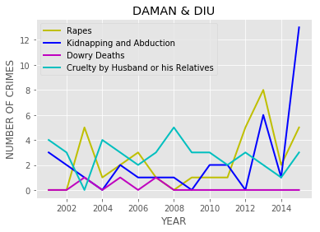
DAMAN & DIU
2014 WAS A VERY GOOD YEAR IN DAMAN & DIU AS NUMBER OF CRIMES AGAINST WOMEN CAME DOWN BUT SAW A INCREASE AS 2015 APPROACHES.

Slide 22
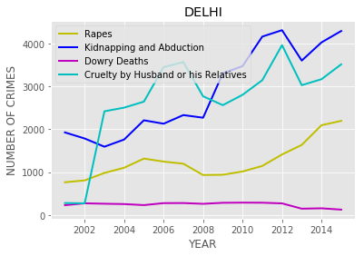
DELHI
NUMBER OF RAPES HAVE BEEN SIGNIFICANTLY INCREASED SINCE 2008.
WHILE NUMBER OF KIDNAPPING AND CRUELTY STILL INCREASING DAY BY DAY.

Slide 23
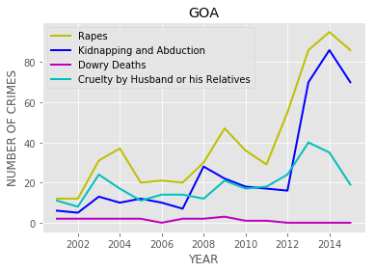
GOA
2014 SAW THE HIGHEST NUMBER OF RAPES TILL 2015 IN GOA.
WHILE DOWRY DEATHS BEING VERY LOW THROUGHOUT.

Slide 24
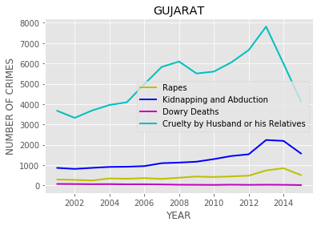
GUJARAT
CRIME RATES HAVE ALMOST DOUBLED SINCE 2001 BY THE END OF 2015.
THOUGH CRUELTY AGAINST WOMEN SAW SOME DECREASE FROM 2013.

Slide 25
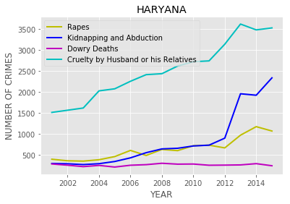
HARYANA
HARYANA BEING PICTURISED AS BEING MORE RURAL THAN URBAN SAW VERY LOW NUMBER OF DOWRY DEATHS.
WHILE CRUELTY BY HUSBAND CASES HAVE INCREASED SIGNIFICANTLY OVER TIME.

Slide 26
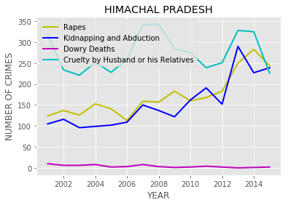
HIMACHAL PRADESH
HIGH INCREASE IN KIDNAPPING AND ABDUCTION CASES FROM 2012 TO 2013.
FALL CRUELTY CASES BY THE END OF 2015.

Slide 27
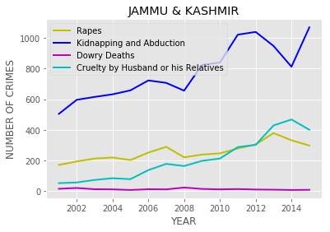
JAMMU & KASHMIR
KIDNAPPING AND ABDUCTION BEING THE HIGHEST COMMITTED CRIME IN J&K.
DOWRY DEATHS ARE VERY LOW.

Slide 28
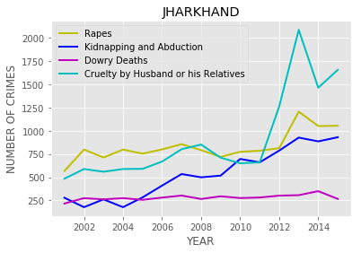
JHARKHAND
SHARP INCREASE IN CRUELTY CASES FROM 2011 TO 2013.
DOWRY DEATHS BEING CONSISTENT AND DIDN’T HAVE MUCH INCREASE THROUGHOUT THE TIME.

Slide 29
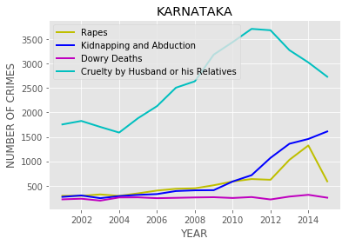
KARNATAKA
CRUELTY BY HUSBAND OR HIS RELATIVES BEING THE HIGHEST COMMITTED CRIME IN KARNATAKA.
WHILE KIDNAPPING AND ABDUCTION CASES STILL INCREASING BY THE END OF 2015.

Slide 30
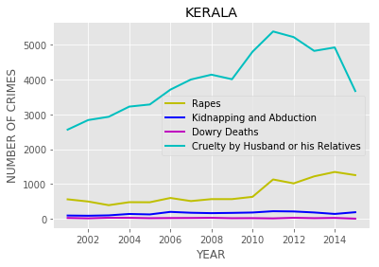
KERALA
CRUELTY BEING THE HIGHEST CRIME AGAINST WOMEN IN KERALA.
DOWRY DEATHS BEING VERY LOW THROUGHOUT.

Slide 31
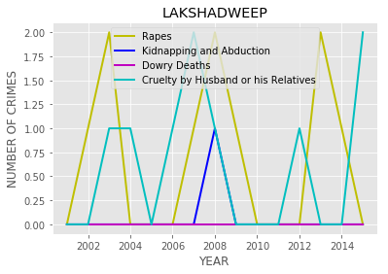
LAKSHADWEEP
LAKSHADWEEP WITH BEING THE LOWEST NUMBER OF CRIMES AMONG ALL OTHER CASES AS COMPARED TO OTHER CASES.
POPULATION DENSITY BEING NOT CONSIDERED.

Slide 32
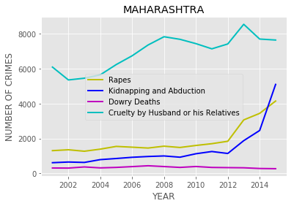
MAHARASHTRA
HIGH INCREASE IN KIDNAPPING AND ABDUCTION CASES FROM 2014.
CRUELTY BY HUSBAND OR HIS RELATIVES BEING THE HIGHEST CRIME.

Slide 33
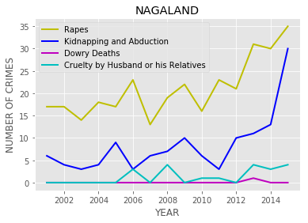
NAGALAND
NUMBER OF RAPES BEING THE HIGHEST CRIME IN NAGALAND.
STEEP INCREASE IN NUMBER OF RAPES SINCE 2014 TILL 2015.

Slide 34

PUNJAB
INCREASE IN NUMBER OF KIDNAPPING AND ABDUCTION CASES AND RAPES SINCE 2011 TILL 2015.
DOWRY DEATHS SAW A FALL SINCE 2001 TILL 2015.

Slide 35

RAJASTHAN
RAJASTHAN BEING HAVING VERY NUMBER OF CRUELTY BY HUSBAND OR HIS RELATIVES.
CONSISTENCY IN DOWRY DEATHS CASES THROUGHOUT THE TIME.

Slide 36

TAMIL NADU
OVERALL DECREASE IN CRIME RATES SINCE 2013 TILL THE END OF 2015.

Slide 37

UTTAR PRADESH
UTTAR PRADESH SAW VERY HIGH NUMBER OF CRUELTY BY HUSBAND OR HIS RELATIVES WITH KIDNAPPING AND ABDUCTION BEING THE HIGHEST.

Slide 38
Visualizations 3 - Dowry Deaths
With these visualizations we tried to show how women's are losing lives for dowry demands in different states.
Changes in Numbers of such incidents also shows how mentality of people changing over time or is it getting worse.
As we can’t put all graphs here, so we have graphs for major cities as follows:

Slide 39






Slide 40






Slide 41






Slide 42






Slide 43
Visualizations 4 - KIDNAPPING AND ABDUCTION
With these visualizations we tried to show Kidnapping and Abduction cases in different states over given span of time.
As we can’t put all graphs here, so we have graphs for major cities as follows:

Slide 44






Slide 45






Slide 46






Slide 48






Slide 49






Slide 50






Slide 51
Visualizations 5 - Cruelty by husband or his Relatives
With these visualizations we tried to show how women face cruelty after marriage by her husband or his relatives in different states.
Changes in Numbers of such incidents also shows how mentality of people changing over time or is it getting worse.
As we can’t put all graphs here, so we have graphs for major cities as follows:

Slide 52






Slide 53






Slide 54






Slide 55






Slide 56






Slide 57






Slide 58
THANK YOU

